Slide 1


Slide 2


Slide 3
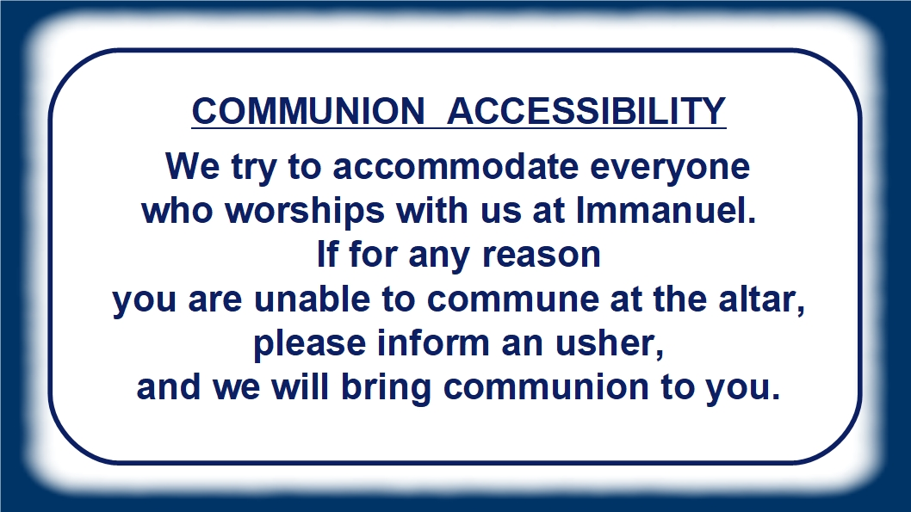

Slide 4


Slide 5


Slide 6


Slide 7

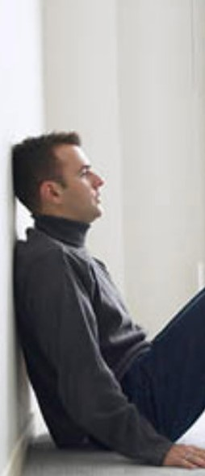


A new 13 week session begins
Tuesday, February 26th
at 6:00 P.M.
in the Youth Room.
Please contact Carol Boyd (354-3758)
or Dave Meyer (354-5864)
for more information.

Slide 8
Info
Contact info
Sample image

Slide 9

Pew Sisters - Journey to the Cross
Pew Sisters will meet one more
Saturday morning at Cabin Creek
on September 8 at 9:00 A.M.
In October, they will return back
to their Monday evening schedule.

Slide 10

“SHAPED BY THE GOSPEL:
LIFE IN THE CHURCH”
This Youth/Adult Bible study
begins September 9 at 9:15 A.M.
in the church fellowship room.
The study is based on letters written by the Apostle Paul to young Timothy, to give him guidance on the issues of church life.
This 12-week study is led
by Pastor Schultz and Pastor Erickson.

Slide 11



EARLY BIRD BIBLE STUDY
Monday mornings at 7:00 A.M.
at the Thunder Bay River Restaurant.
Our current study is the book of 1 KINGS.
** We will not meet on September 3
due to the Labor Day holiday!

Slide 12

“UNSHAKABLE”
A new 12-week Bible study by Max Lucado
begins September 9 at 9:15 A.M.
Deacon Al Kersten will lead this short
DVD/workbook based study.
Check next week’s bulletin for the location.

Slide 13
MEN’S BREAKFAST & BIBLE STUDY
Begins Saturday, September 15 at 7:30 a.m.
in the church fellowship room.
Menu:
Eggs, sausage, sweet rolls, and coffee
This breakfast will be hosted
every 2nd Saturday of the month
by the Board of Lay Ministry.

Slide 14

Close the Back Door meets
every Thursday at 6:00 P.M.
in the library/lounge area
of the Church
Join Pastor Erickson
for this important outreach ministry.
CLOSE THE BACK DOOR

